Slide 1
Text Mining
L05. data collection and annotation

Slide 2
Today’s lecture
Quiz about week 4
Evaluation exercise
How to get example data?
Challenges of manual annotation
Inter-rater agreement

Slide 3
Quiz about week 4
The task of authorship attribution is...
Binary
Multi-class
Multi-label
I don't know what authorship attribution is

Slide 4
Quiz about week 4
We have a collection of 10,000 documents. The term shark occurs in 10 documents. What is the idf for shark?
3
4
5
10

Slide 5
Quiz about week 4
We have a document with length 100 in which the term shark occurs once. According to the log-variant of term frequency, what is the tf of shark for this document?
-2
0.01
0
1

Slide 6
Quiz about week 4
What is add-one smoothing in Naive Bayes?
Adding one to the occurrence of each category
Adding one for each term in the vocabulary
Adding one for each term in the vocabulary for each category
Adding one to the posterior probability of a class given a document

Slide 7
Quiz about week 4
Have you worked on the exercise of week 4 (text categorization)?
I have completed it
I have completed at least half of it
I have started
No

Slide 8
Exercise: text categorization
https://scikit-learn.org/stable/tutorial/text_analytics/working_with_text_data.html
Some possible challenges you might have encountered:
compatibility warnings (Python 3/Python 2)
version errors? #from sklearn.model_selection import GridSearchCV from sklearn.grid_search import GridSearchCV
Please contact the TAs if you have any questions

Slide 9
Exercise (week 4)
We have evaluated a classifier for spam on 1000 messages
 | True (reference): spam | True (reference): no spam
Assigned: spam | 600 | 400
Assigned: no spam | 200 | 800

Slide 10
Exercise (week 4)
We have evaluated a classifier for spam on 2000 messages
 | True (reference): spam | True (reference): no spam
Assigned: spam | 600 | 400
Assigned: no spam | 200 | 800
What is the precision for the ‘spam’ class?
What is the recall for the ‘spam’ class?
What is the precision for the ‘no spam’ class?
What is the recall for the ‘no spam’ class?

Slide 11
Exercise (week 4)
We have evaluated a classifier for spam on 2000 messages
 | True (reference): spam | True (reference): no spam
Assigned: spam | 600 | 400
Assigned: no spam | 200 | 800
What is the precision for the ‘spam’ class?
What is the recall for the ‘spam’ class?
What is the precision for the ‘no spam’ class?
What is the recall for the ‘no spam’ class?
600/1000 = 0.60
600/800=0.75
800/1000=0.80
800/1200≈0.67

Slide 12
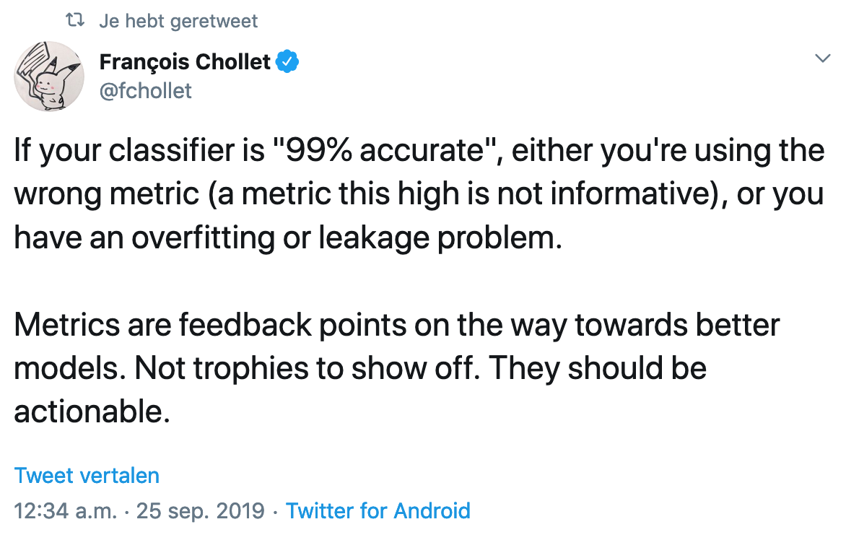
Classifier evaluation

Slide 13
Example data

Slide 14
Why do we need example data?
In supervised learning we need example data for training and evaluation
labelled data, reference data, gold-standard data, ground truth data
Doc id | Content | Class
1 | request urgent interest urgent | Spam
2 | assistance low interest deposit | Spam
3 | symposium defence june | No spam
4 | siks symposium deadline june | No spam
5 | registration assistance symposium deadline | ?

Slide 15
How to get example data
Use existing labelled data
Create new labelled data

Slide 16
Existing labelled data

Slide 17
How to get example data
1. Existing labelled data
A benchmark dataset created by someone else
Existing human labels
Labelled user-generated content

Slide 18
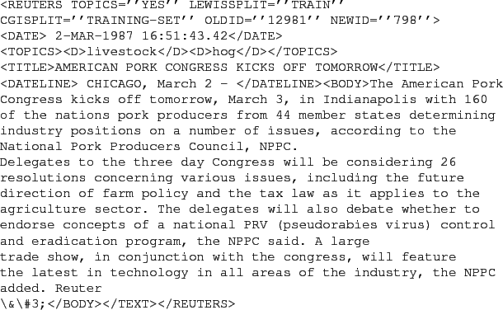
Benchmark data
Benchmark datasets are used to evaluate and compare methods
Classic text classification benchmark: Reuters-21578

Slide 19
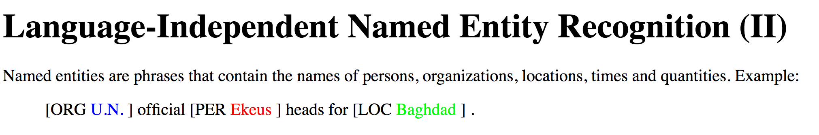
Benchmark data
Benchmark data is often created in the context of shared tasks
Classic Named Entity Recognition (NER) benchmark: CoNLL-2003 shared task

Slide 20
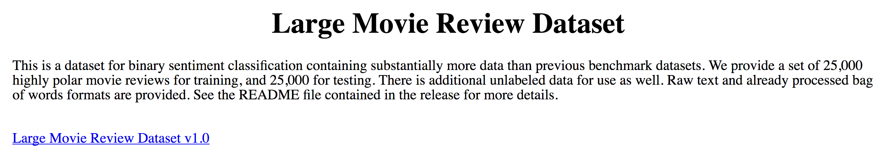
Benchmark data
Sentiment analysis benchmark: movie review dataset

Slide 21
Benchmark data
Advantages
High-quality
Re-usable
Compare results to others
Disadvantages
Not available for every specific problem
(e.g. suppose we want to extract medications and side effects mentioned in patient support groups)

Slide 22
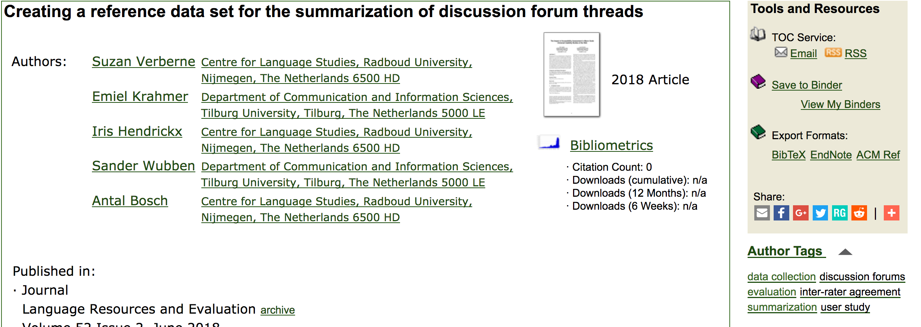
Existing human labels
Labels that were added to items by humans, but not originally created for training automatic tools, e.g.
keywords in digital libraries (e.g. http://dl.acm.org)

Slide 23
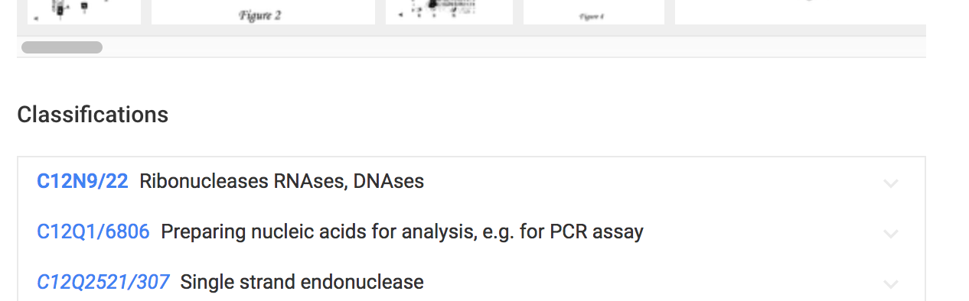
Existing human labels
Labels that were added to items by humans, but not originally created for training automatic tools, e.g.
the international patent classification system:
Millions of patents manually classified in a hierarchical classification system by patent experts

Slide 24
Existing human labels
Advantages:
High-quality
Potentially large
Often freely available
Disadvantages:
Not available for every specific problem
Not always directly suitable for training classifiers

Slide 25
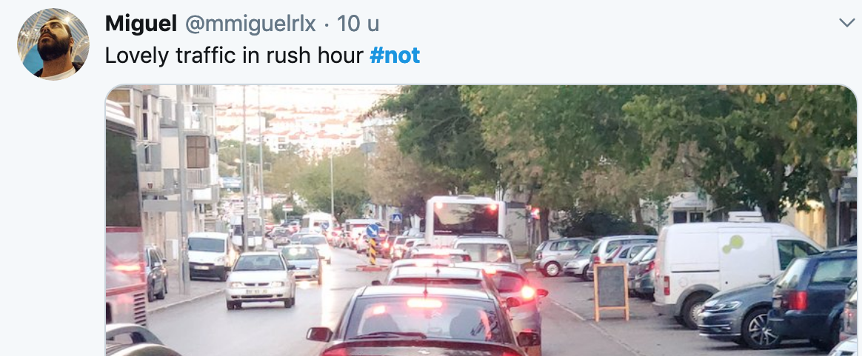
Labelled User-generated content
Hashtags on Twitter, e.g.
Use the hashtag #not to learn to detect sarcasm in text

Slide 26
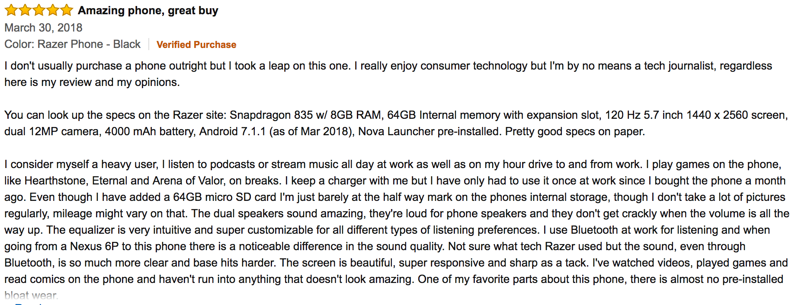
Labelled User-generated content
Scores in product reviews
to learn sentiment and opinion

Slide 27
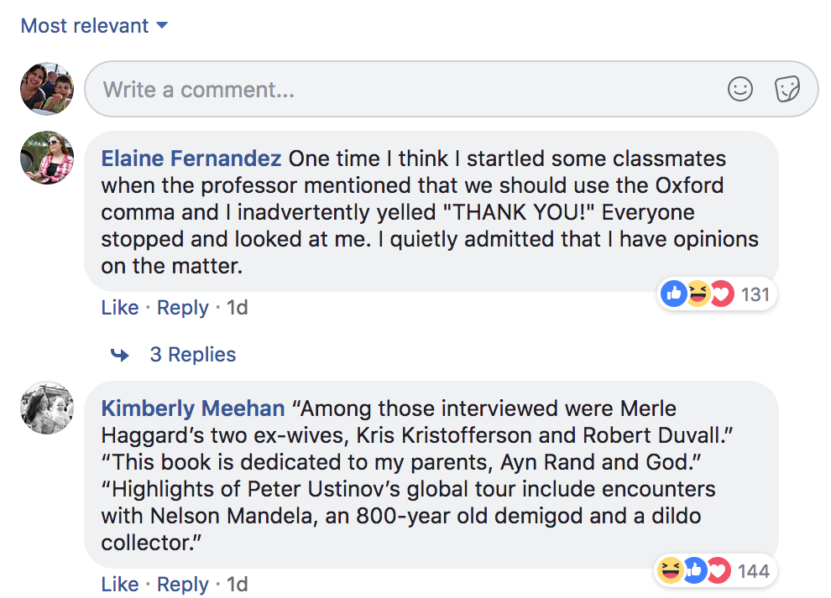
Labelled User-generated content
Likes of Facebook posts to learn which comments are the most interesting

Slide 28
Labelled User-generated content
Advantages
Potentially large
Human-created
Freely available
Disadvantages
Noisy: often inconsistent
May be low-quality
Indirect signal

Slide 29
Create labelled data

Slide 30
Create labelled data
Make a sample of items
Define a set of categories
Write annotation guidelines version 1
Test and revise the guidelines with new annotators until the guidelines are sufficiently clear
The task should be clearly defined
But not trivial (‘mark all numbers in the text’)

Slide 31
Create labelled data
Human annotation
Experts
Crowdsourcing (Amazon Mechanical Turk, Crowdflower)
Compare the labels by different annotators to estimate the reliability of the data (inter-rater agreement)

Slide 32
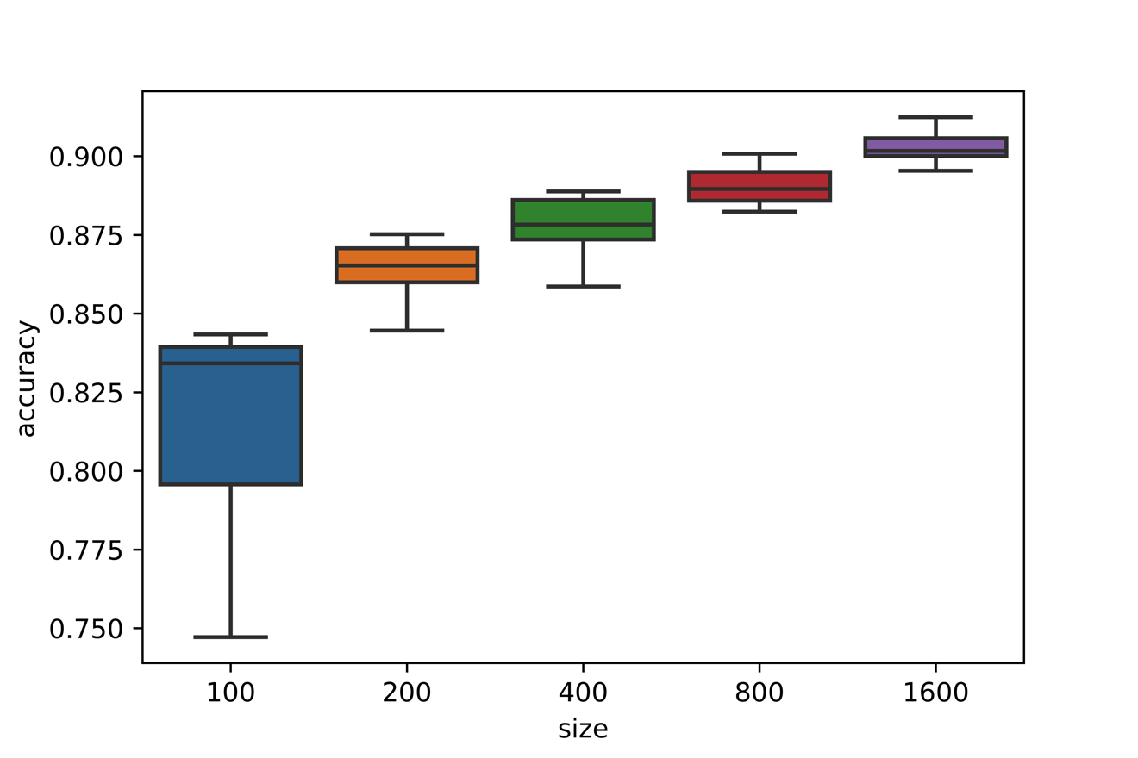
Create labelled data
How many examples do you need?
At least dozens/hundreds per category
The more, the better
The more difficult the problem, the more examples needed
Example results for a binary classification task with increasing number of training examples
Van der Burgh, B., & Verberne, S. (2019). The merits of Universal Language Model Fine-tuning for Small Datasets--a case with Dutch book reviews. arXiv preprint arXiv:1910.00896.

Slide 33
Crowdsourcing
“Crowdsourcing is the act of taking a job traditionally performed by a designated agent (usually an employee) and outsourcing it to an undefined, generally large group of people in the form of an open call” -- Jeff Howe, 2006
Useful for tasks that humans are typically good at while computers need a lot of examples to do it properly
and where no experts are needed (no domain-specific knowledge needed)
e.g. object detection in images, name detection in texts

Slide 34
Crowdsourcing
Main challenge: quality control
Don’t pay too little
Have a check in the task set-up (e.g. workers need to answer one dummy question to make sure they pay attention)
Say that their work is compared to expert annotations (also if you don’t)
Evaluate the reliability of the data by measuring the inter-rater agreement (this is discussed next)

Slide 35
Data annotation
Exercises

Slide 36
Example task
Make a sample of items
Define a set of categories
Write annotation guidelines version 1
Test and revise the guidelines with new annotators until the guidelines are sufficiently clear
Example goal: we want to train a classifier that can recognize the sharing of personal experiences online.
Example task: label a set of forum messages according to the question “Does the post contain a personal experience? (y/n)”
Exercise: create a single ordered list of 41 items [y,n] (sample in pdf also on Brightspace, week 5)

Slide 37
Discussion
What difficulties did you encounter?

Slide 38
Discussion
What difficulties did you encounter?
Task definition
The option to answer ‘?’
The need for clear guidelines
What about the reliability of your annotations?
Make a sample of items
Define a set of categories
Write annotation guidelines version 1
Test and revise the guidelines with new annotators until the guidelines are sufficiently clear
Human annotation
Compare the labels by different annotators to estimate the reliability of the data

Slide 39
Inter-rater agreement

Slide 40
Inter-rater agreement
Human labelled example data = ‘the truth’ for the classifier
both training and evaluation
But 2 human classifiers do never fully agree
We therefore always have part of the example data labelled by 2 or 3 raters and then compute the inter-rater agreement
to know the reliability of the example data
also a measure for the difficulty of the task
Measure for inter-rater agreement: Cohen’s Kappa

Slide 41
Cohen’s Kappa
Pr(a) = actual (measured) agreement: percentage agreed
Pr(e) = expected (chance) agreement (based on the probabilities of occurrence of each of the values)

Slide 42
Cohen’s Kappa
Agreement table |  | A2
 |  | Yes | No
A1 | Yes | 20 | 5
 | No | 10 | 15
Pr(a) = actual (measured) agreement: percentage agreed
Pr(e) = expected (chance) agreement
Pr(a) =

Slide 43
Cohen’s Kappa
Agreement table |  | A2
 |  | Yes | No
A1 | Yes | 20 | 5
 | No | 10 | 15
Pr(a) = actual (measured) agreement: percentage agreed
Pr(e) = expected (chance) agreement
Pr(a) = (20+15)/(20+5+10+15) = 35/50 = 0.70

Slide 44
Cohen’s Kappa
Agreement table |  | A2
 |  | Yes | No
A1 | Yes | 20 | 5
 | No | 10 | 15
Pr(e):
A1 says ‘yes’ to 25 items → 50% of all items
A2 says ‘yes’ to 30 items → 60% all items
Pr(e,yes) = 0.50*0.60 = 0.30
Pr(e,no) =

Slide 45
Cohen’s Kappa
Agreement table |  | A2
 |  | Yes | No
A1 | Yes | 20 | 5
 | No | 10 | 15
Pr(e):
A1 says ‘yes’ to 25 items → 50% of all items
A2 says ‘yes’ to 30 items → 60% all items
Pr(e,yes) = 0.50*0.60 = 0.30
Pr(e,no) = 0.50*0.40 = 0.20
Pr(e) = Pr(e,yes) + Pr(e,no) = 0.50
Notes:
The probability rule of sum gives the situations in which the probability of a union of events can be calculated by summing probabilities together. It is often used on mutually exclusive events, meaning events that cannot both happen at the same time.

Slide 46
Cohen’s Kappa
Agreement table |  | A2
 |  | Yes | No
A1 | Yes | 20 | 5
 | No | 10 | 15
Pr(e):
A1 says ‘yes’ to 25 items → 50% of all items
A2 says ‘yes’ to 30 items → 60% all items
Pr(e,yes) = 0.50*0.60 = 0.30
Pr(e,no) = 0.50*0.40 = 0.20
Pr(e) = Pr(e,yes) + Pr(e,no) = 0.50
K = (0.70 – 0.50)/(1 – 0.50) = 0.20/0.50 = 0.40

Slide 47
interpretation of Kappa
< 0: no agreement
0–0.20: slight agreement
0.21–0.40: fair agreement
0.41–0.60: moderate agreement
0.61–0.80: substantial agreement
0.81–1: almost perfect agreement
Landis, J. R., & Koch, G. G. (1977). The measurement of observer agreement for categorical data. biometrics, 159-174.

Slide 48
Exercise
Compare your y/n labels to the ones of your neighbour
Make the agreement table
Compute the inter-rater agreement between your annotations in terms of Cohen’s Kappa
Example repeated on the next slide

Slide 49
Cohen’s Kappa example
Agreement table |  | A2
 |  | Yes | No
A1 | Yes | 20 | 5
 | No | 10 | 15
Pr(e):
A1 says ‘yes’ to 25 items → 50% of all items
A2 says ‘yes’ to 30 items → 60% all items
Pr(e,yes) = 0.50*0.60 = 0.30
Pr(e,no) = 0.50*0.40 = 0.20
Pr(e) = Pr(e,yes) + Pr(e,no) = 0.50
K = (0.70 – 0.50)/(1 – 0.50) = 0.20/0.50 = 0.40

Slide 50
Conclusions

Slide 51
Homework
Read:
Finin et al. (2010) “Annotating named entities in Twitter data with crowdsourcing”.
McHugh (2012). “Interrater reliability: the kappa statistic” (reference paper for the explanation of Kappa)
Complete assignment 1: text categorization
See Brightspace: Assignments -> Assignment 1
Deadline: October 18
Submit your report as PDF and your python code as separate file.
Your report should not be longer than 3 pages

Slide 52
Reminder about course grading
The assessment of the course consists of
a written exam (50% of course grade)
practical assignments (50% of course grade)
two smaller assignments (10% each) during the course
one more substantial assignment (30%) at the end of the course
Passing the course:
The average grade for the written exam and the practical assignments should be 5.5 or higher in order to complete the course.
If a task is not submitted the grade for that task is 0
Re-sit deadline for assignment 1 and 2: January 16. Maximum grade at re-sit is 6.

Slide 53
After this lecture…
You can describe the advantages and disadvantages of using benchmark data, existing human-labelled data, user-generated content, and crowdsourcing
You can describe the challenges of manual annotations
You can calculate inter-rater agreement between two human annotators in terms of Cohen’s Kappa

